Slide 1

Features in the house to help with heat transfer Year 11 Physics
Mrs Martin

Slide 2



Do not delete this slide. It is hidden from your show. You can use it to copy and paste the relevant prompt boxes into your presentation. Click once on the white space to select it for copying. Once it is in your presentation you can double click on the white space to add text. The box will automatically resize to fit your text. The next slide is also hidden and included as an example only.
Make the Connection
Check for Understanding
Teacher Cue
Vocabulary
Extension
Hints

Slide 3
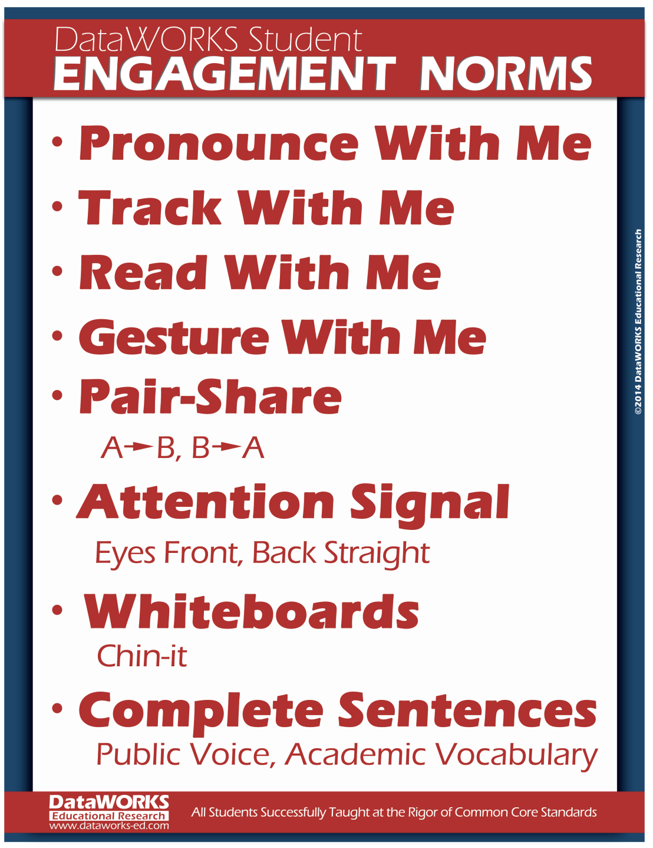
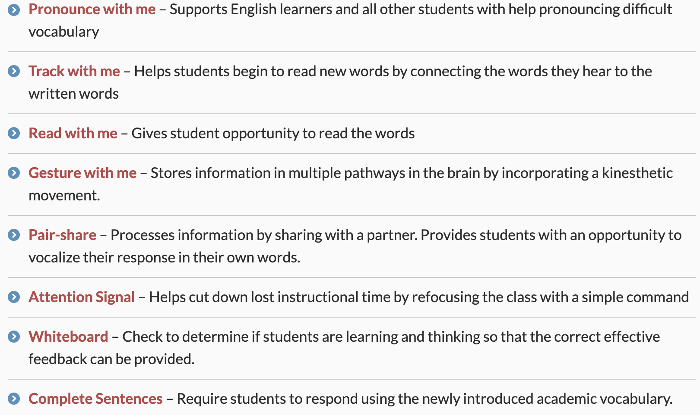

Slide 4
Heating in Cooling in Houses
When building a house the main goal is to allow the house to remain cool in the summer and cool in the winter.
This is achieved by placing items in the house that prevent heat from entering and leaving the house.

Slide 5
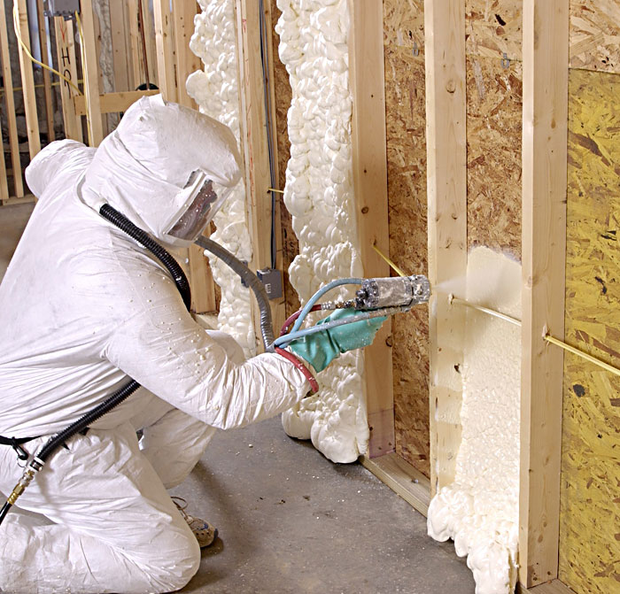
Insulation
Insulation is a poor conductor of heat and acts as a barrier for the heat. Insulation is found in walls and ceilings.
In summer it prevents heat from entering the house in summer.
Prevents heat from leaving the house in winter.
This Photo by Unknown Author is licensed under CC BY-SA

Slide 6
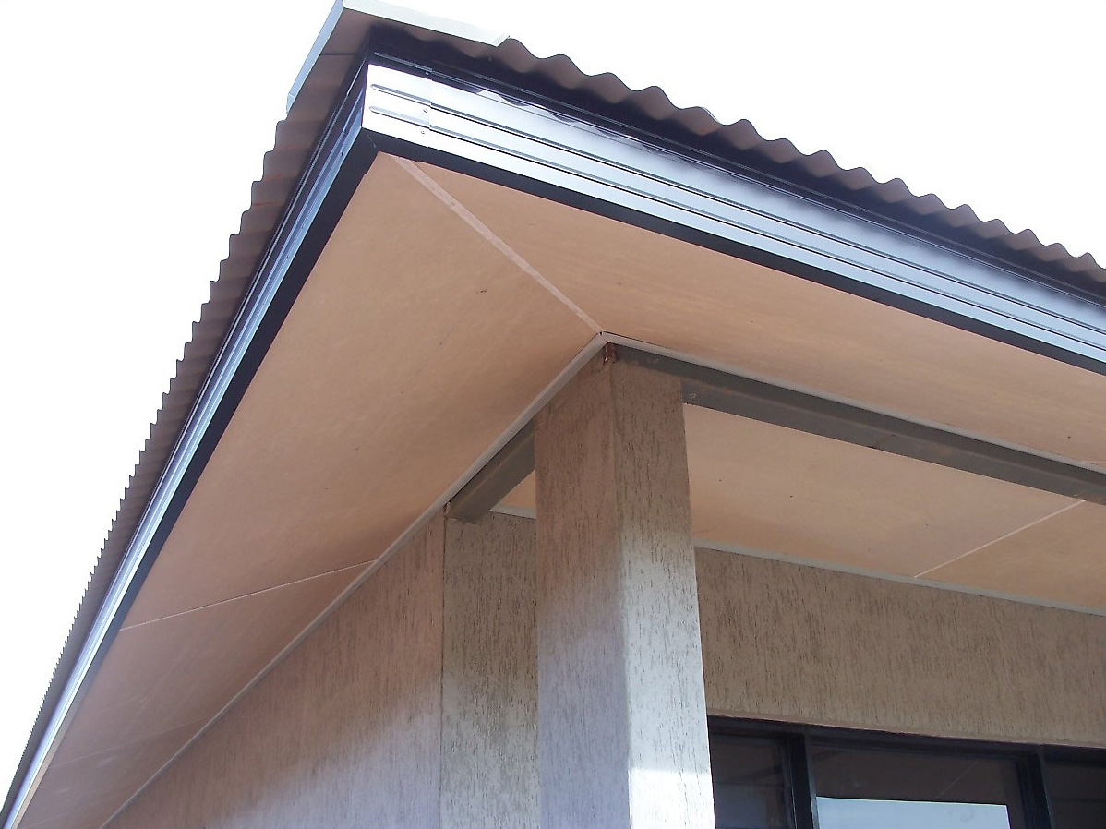
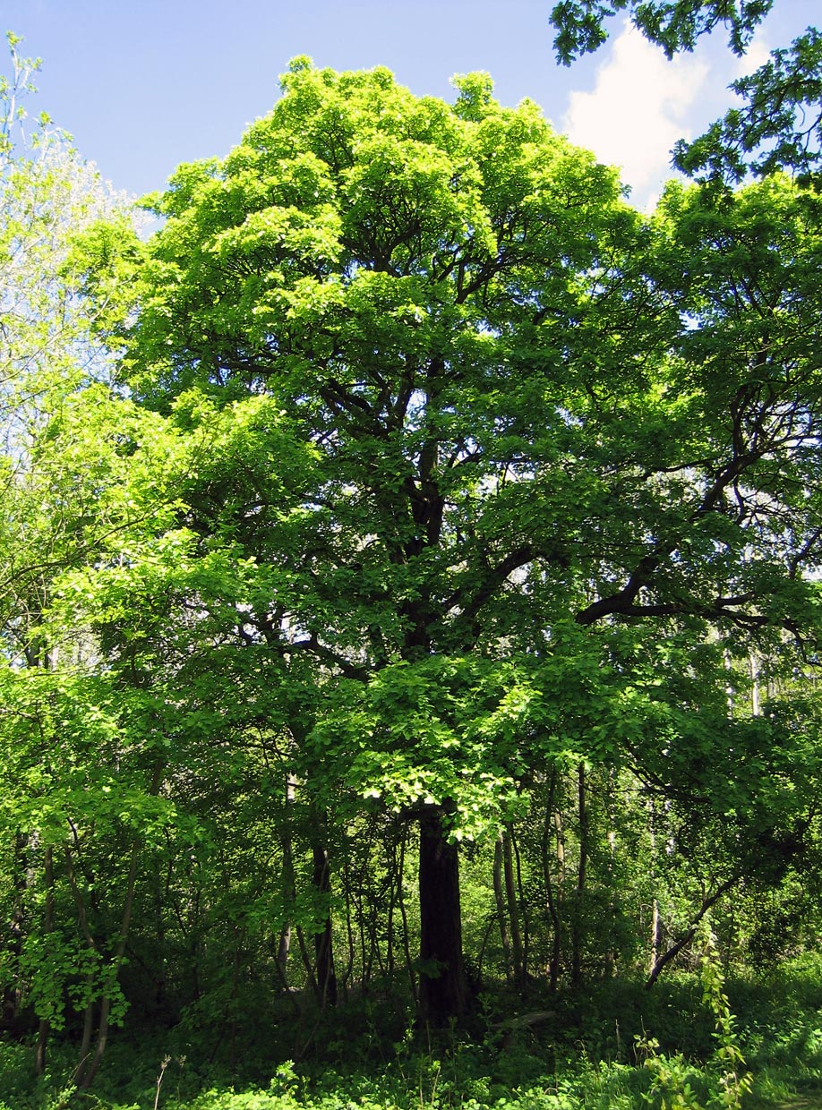
Eaves and Trees
Eaves are the an extension of the roof over the walls.
In summer, the eaves and trees provide shade over the walls and windows which prevent the transfer of heat through radiation.
Eaves can trap heat in the winter, which reduces heat loss.
This Photo by Unknown Author is licensed under CC BY-SA
This Photo by Unknown Author is licensed under CC BY-SA

Slide 7
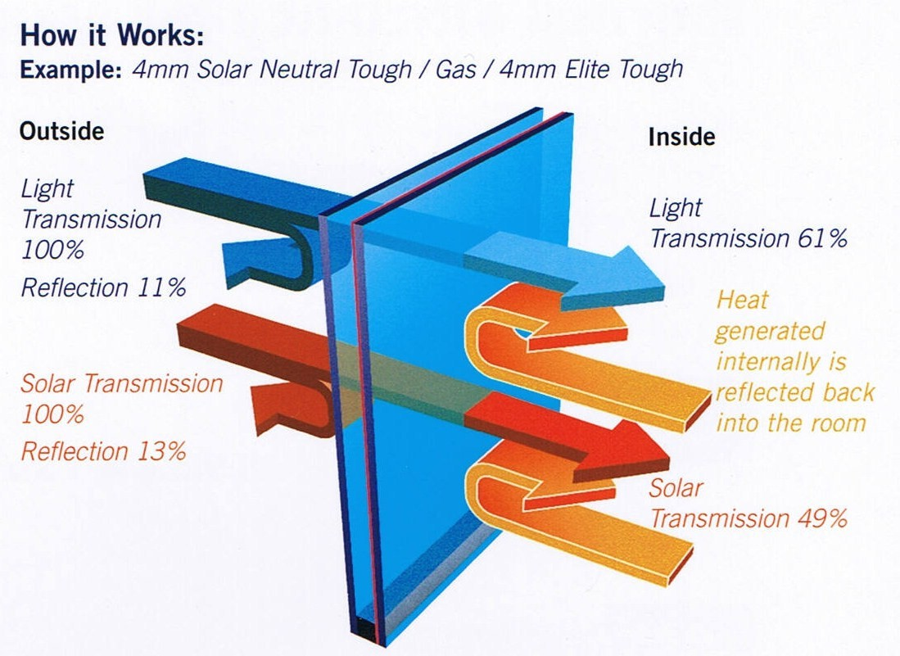
Double Glazed Windows
Double glazed windows are insulated windows made of two or more sheets of glass. There is a trapped layer of air between the glass which acts as an insulator.
In summer this increases the reflection of heat from outside.
In winter this prevents the heat from inside the house escaping.
This Photo by Unknown Author is licensed under CC BY-SA

Slide 8
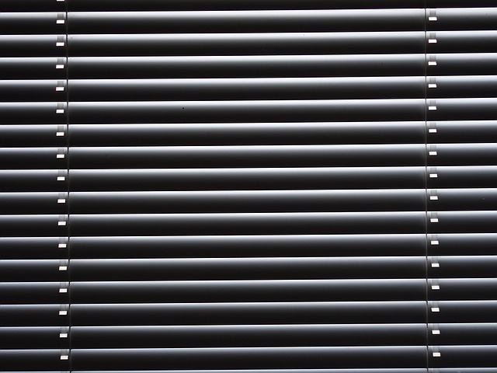
Blinds
Highly reflective blinds, in the right colour can reduce heat transfer in the house by 77%.
The white colouring allows for the reflection of heat. The reflectiveness on the blinds also helps to reflect the heat from entering.
Blinds prevent heat from entering the house through summer and heat from leaving during winter.

